Slide 1
Chapter 9: Virtual Memory
Narzu Tarannum
CSE, BU

Slide 2
Intro. of virtual memory
Virtual memory separation of user logical memory from physical memory.
  Only part of the program needs to be in memory for execution.
  Logical address space can therefore be much larger than physical address space.
An examination of real programs show that: Programs often have code to handle unusual error conditions. Since these errors seldom, if ever, occur in practice, this code is almost never executed.
Virtual memory is a storage scheme where secondary memory can be treated as though it is a part of main memory and large process can be stored in it. Only the part of the process that is actually needed for execution will be loaded on to the actual main memory.
Virtual memory can be implemented via:
  Demand paging
  Demand segmentation
Virtual memory involves the separation of logical memory as perceived by users from physical memory.
This separation, allows an extremely large virtual memory to be provided for programmers when only a smaller physical memory is available.

Slide 3
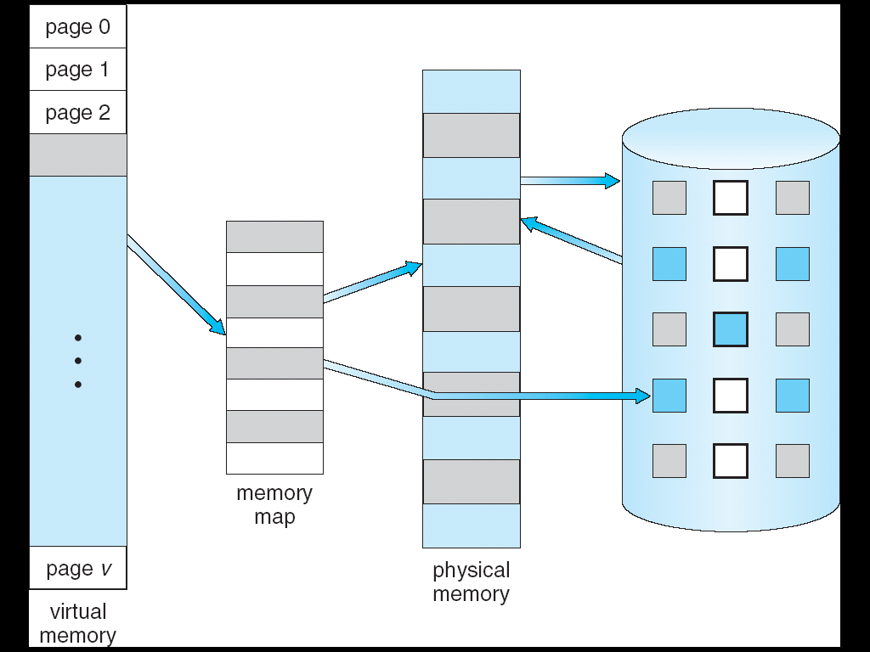
Virtual Memory That is Larger Than Physical Memory
⇒

Slide 4
Demand Paging
Bring pages into memory only when it is needed or pages are only loaded when they are demanded during program execution. Pages are never accessed are thus never loaded into physical memory.-------This is called Demand Paging.
A demand paging system similar to a paging system with swapping where processes reside in secondary memory.
In pure swapping/ pure demand paging, where entire program is swapped from secondary storage to main memory during the process startup.
Commonly, to achieve this process a page table implementation is used. The page table maps logical memory to physical memory.
Demand paging follows that pages should only be brought into memory if the executing process demands them. This is often referred to as lazy swapper as only those pages demanded by the process are swapped from secondary storage to main memory.
Rather than swapping the entire process into memory, since we are now viewing a process as a sequence of pages, rather than as one large contagious address space, use the term SWAPPER is technically incorrect here- so in concern with demand paging we will use the term pager.

Slide 5

Demand Paging
Advantages
  Less memory needed
  Faster response
  More users/ Degree of multiprogramming increase.
  Less I/O needed
  Reduce memory requirement
  Swap time is also reduce
Disadvantages
  Page fault interrupt
Hardware support needed for demand paging
  Page table with valid / invalid bit
  Secondary memory

Slide 6
Valid Invalid bit
The page table uses a bitwise operator to mark if a page is valid or invalid. A valid page is one that currently resides in main memory. An invalid page is one that currently resides in secondary memory. When a process tries to access a page, the following steps are generally followed:
  Attempt to access page.
  If page is valid (in memory) then continue processing instruction as normal.
  If page is invalid then a page-fault trap / page-fault interrupt occurs.
  Page is needed ⇒ reference to it
    invalid reference ⇒ abort
    not-in-memory ⇒ bring to memory
  Restart the instruction that was interrupted by the operating system trap.
With each page table entry a valid–invalid bit is associated
(1/ v ⇒ in-memory, 0 / i ⇒ not-in-memory)

Slide 7

Page Table When Some Pages Are Not in Main Memory

Slide 8
Page Fault
If there is ever a reference to a page, first reference will trap to OS ⇒ page fault
OS looks at another table to decide:
  Invalid reference ⇒ abort.
  Just not in memory.
Find empty/ free frame.
Load page from disk into frame.
Reset tables, validation bit = 1.
Restart instruction that caused page fault

Slide 9

Steps in Handling a Page Fault

Slide 10
Problems of demand paging
With the help of demand paging, we are increasing our degree of multi-programming by loading only the required pages into memory hence facilitating the possibility of having more processes loaded into memory--- this could lead to over allocation of memory.
Eg.
Suppose we have 40 frames in memory.
We have 6 processes each of which has 10 pages but uses only 5 at the moment.
We can load this (6 X 5) = 30 pages into the memory
So all the processes are executing simultaneously.
Still we have 10 frames free.
Now at some point let’s say all the 6 processes want to use all their 10 pages. So we need to load the remaining (6 X 5) = 30 pages into the memory, while we have only 10 free frames.

Slide 11

Need For Page Replacement

Slide 12
Performance of Demand Paging
Demand paging can significantly affect the performance of computer system
Let’s compute the effective access time (EAT) for a demand page memory:
  If “p” be the probability of a page fault where 0 ≤ p ≤ 1.
    p = 0 no page faults
    p = 1, every reference is a fault
  We should expect p to be close to 0 or only a few page fault

Slide 13
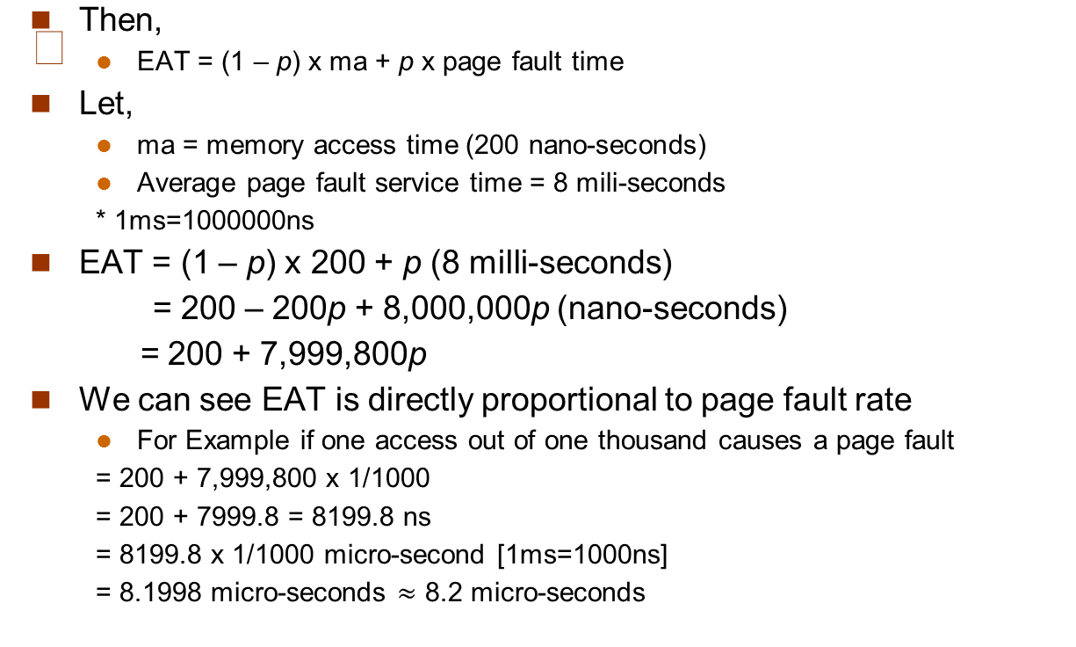
Performance of Demand Paging

Slide 14
Performance of Demand Paging
EAT= 8.2 micro-seconds
This is a slowdown by a factor of 40!!
If want performance degradation < 10 percent
  220 > 200 + 7999800p [were EAT= 200 + 7999800p]
  220 - 200 > 7999800p
  20 > 7999800p
  p < 20 / 7999800
  p < 20 / 8000,000
  p < 1/400,000
  p < .0000025
It means one page fault in every 400,000 memory accesses
So, we can conclude, it is important to keep the page fault rate very low in a demand paging system

Slide 15
What happens if there is no free frame?
Page replacement – is the technique of swapping out pages from physical memory when there are no more free frames available, in order to make room for other pages which has to be loaded to the physical memory.
If a process wants to use/access a page which is not present in physical memory, it will cause a page fault.—So, that page has to be now loaded into memory.
But if there are no free frames available to load that page, what should we do than?
  We look for an occupied frame that is not being used currently.
  We free that frame by writing it’s contents to the swap space (disk)
  We update the page tables to indicate that the page is now no more in memory.
  We load the page of the process that caused the page fault to occur into the freed frame

Slide 16
Basic Page Replacement
Find the location of the desired page on disk
Find a free frame:
- If there is a free frame, use it
- If there is no free frame, use a page replacement algorithm to select a victim frame
Bring the desired page into the (newly) free frame; Update the page and frame tables.
Continue the process by restarting the instruction that caused the trap

Slide 17

Page Replacement

Slide 18
Flowchart of Demand Paging and page replacement
Start Processing
An Instruction
Is there a free frame
CPU will generate address
No
Select Page for
replacement
Generate Address
Check MPT of job from which it is selected
Page Number generated
Yes
Adjust PMT
Get disk address of
new page from FMT
Page in MM
Page fault
interrupt
Was Page Modified
No
No
Read in Page
Yes
Fetch data and
Compute Instruction
Yes
Adjust PMT
Write back
on disk
Advance to Next
Instruction
Restart interrupt
instruction

Slide 19
Page Replacement
If no frames are free, two page transfers (one out and one in) are required.
Use modify (dirty) bit to reduce overhead of page transfers – only modified pages are written to disk---the modify bit is set when a page has been modified.
Page replacement completes separation between logical memory and physical memory – large virtual memory can be provided on a smaller physical memory
Solve two problems in demand paging implementation:
Frame-allocation algorithm determines
  How many frames to give each process
  Which frames to replace
Page-replacement algorithm
  Want lowest page-fault rate on both first access and re-access

Slide 20

Graph of Page Faults Versus The Number of Frames

Slide 21
Page Replacement Algorithms
  Want lowest page-fault rate on both first access and re-access
Evaluate algorithm by running it on a particular string of memory references (reference string) and computing the number of page faults on that string
  String is just page numbers, not full addresses
  Repeated access to the same page does not cause a page fault
  Results depend on number of frames available
In all our examples, the reference string of referenced page numbers is
7,0,1,2,0,3,0,4,2,3,0,3,0,3,2,1,2,0,1,7,0,1

Slide 22

First-In-First-Out (FIFO) Algorithm
  Reference string: 7,0,1,2,0,3,0,4,2,3,0,3,0,3,2,1,2,0,1,7,0,1
3 frames (3 pages can be in memory at a time per process)
15 page faults

Slide 23
First-In-First-Out (FIFO) Algorithm
The page which brought first will be replace first
Reference string: 1, 2, 3, 4, 1, 2, 5, 1, 2, 3, 4, 5
3 frames (3 pages can be in memory at a time per process)
4 frames
FIFO Replacement – Belady’s Anomaly
  more frames ⇒ more page faults
1
1
4
5
2
2
1
3
9 page faults
3
3
2
4
1
1
5
4
2
2
1
5
10 page faults
3
3
2
4
4
3

Slide 24

FIFO Illustrating Belady’s Anomaly

Slide 25

Optimal Algorithm
Replace page that will not be used for longest period of time
  9 is optimal for the example
How do you know this?
  Can’t read the future
Used for measuring how well your algorithm performs

Slide 26
Optimal Algorithm
Replace page that will not be used for longest period of time
4 frames example
1, 2, 3, 4, 1, 2, 5, 1, 2, 3, 4, 5
How do you know this?
Used for measuring how well your algorithm performs
1
4
2
6 page faults
3
4
5

Slide 27
Least Recently Used (LRU) Algorithm
LRU replaces page that has not been used for the longest time
Use the recent past to predict the future
Reference string: 1, 2, 3, 4, 1, 2, 5, 1, 2, 3, 4, 5
1
5
2
8 page faults
3
5
4
4
3

Slide 28

Least Recently Used (LRU) Algorithm
Use past knowledge rather than future
Replace page that has not been used in the most amount of time
Associate time of last use with each page
12 faults – better than FIFO but worse than OPT
Generally good algorithm and frequently used
But how to implement?

Slide 29
LRU Algorithm (Cont.)
Counter implementation
  Every page entry has a counter; every time page is referenced through this entry, copy the clock into the counter
  When a page needs to be replaced, look at the counters to determine which has the oldest time-of-access
Stack implementation – keep a stack of page numbers in a double link form:
  Page referenced -> move it to the top of stack
    bottom of stack will be the LRU page
    requires 6 pointers to be changed
  No search for replacement
  LRU and OPT are cases of stack algorithms that don’t have Belady’s Anomaly

Slide 30

Use Of A Stack to Record The Most Recent Page References

Slide 31
Thrashing
It is a situation, if the system spends more time in paging/swapping instead of their execution.
If a process does not have “enough” frames, the page-fault rate is very high. This leads to:
  low CPU utilization
  operating system thinks that it needs to increase the degree of multiprogramming
  another process added to the system
Thrashing ≡ a process is busy swapping pages in and out

Slide 32

Thrashing (Cont.)

Slide 33
Demand Paging and Thrashing
Why does demand paging work?
Locality model
  Locality = set of pages in active use
  Process migrates from one locality to another, e.g. main function, subroutine
  Localities may overlap
Why does thrashing occur?
  size of locality > size of allocated frames

Slide 34

Page-Fault Frequency Scheme
Establish “acceptable” page-fault rate
  If actual rate too low, process loses frame
  If actual rate too high, process gains frame

Slide 35
Other Issues -- Prepaging
Prepaging
  To reduce the large number of page faults that occurs at process startup
  Prepage all or some of the pages a process will need, before they are referenced
  But if prepaged pages are unused, I/O and memory was wasted
  Assume s pages are prepaged and a fraction α of the s pages is used (0 <= α <= 1)
    Is cost of s * α saved pages faults > or < than the cost of prepaging s * (1- α) unnecessary pages?
    α near zero ⇒ prepaging loses
    α near one ⇒ prepaging wins

Slide 36
Other Issues – Page Size
Page size selection must take into consideration:
  fragmentation
  table size
  I/O overhead
  locality

Slide 37
End of Chapter 9

